Slide 1



Development of master curricula for natural disasters risk management in Western Balkan countries
Partner presentation – University of Messina
Prof. Giuseppe Tito Aronica
University of Messina – Department of Engineering, ITALY
NatRisk Kick-off meeting
Nis, Serbia 15th December 2016
Project number: 573806-EPP-1-2016-1-RS-EPPKA2-CBHE-JP
"This project has been funded with support from the European Commission. This publication reflects the views only of the author, and the Commission cannot be held responsible for any use which may be made of the information contained therein"

Slide 2
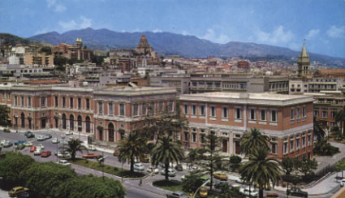

Development of master curricula for natural disasters risk management in Western Balkan countries
Introduction
The University of Messina was founded in 1548 by S. Ignacio of Loyola as first Jesuit college in the world. As matter of fact is the oldest University in Sicily and one of the oldest in Italy.
The University of Messina today enrols about 25.000 students, and counts 12 departments covering almost all academic fields. There are 42 undergraduate courses, 33 Master courses and 6 one cycle master degree programmes.
PhD Courses are also available in different research fields. UniMe counts about 1344 administrative staff and 1181 academic staff.

Slide 3
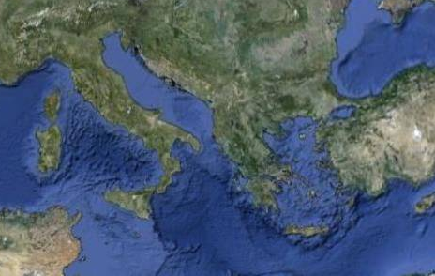
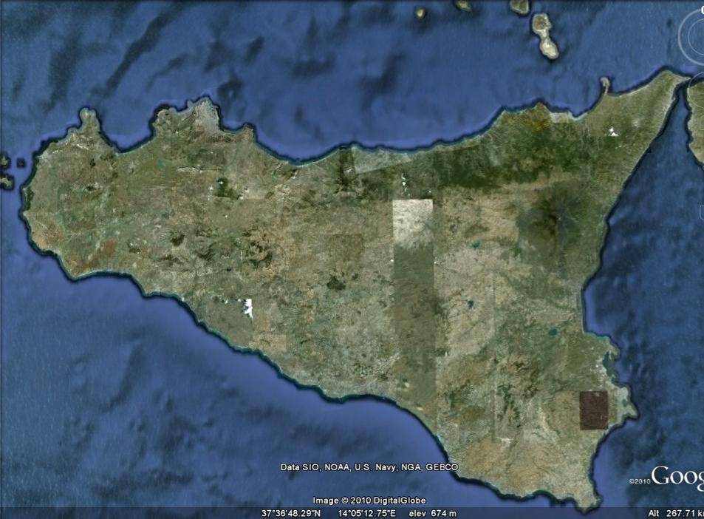
Development of master curricula for natural disasters risk management in Western Balkan countries
Messina (Messanion) is one of the most ancient city in the Mediterranean as was founded by Greek colons around 750 B.C.
Nis
770 km
Messina
Palermo
Messina
In 1908 was completely destroyed by and earthquake and rebuilt soon after
Today is the third largest city in Sicily with a population of about 250,000 after Palermo (960,000) and Catania (500,000)
M. Etna
Sicily
Catania
Siracusa

Slide 4
Development of master curricula for natural disasters risk management in Western Balkan countries
Introduction
The University of Messina will connect the NatRisk project with:
Course of Master Degree in Civil Engineering
Course of Degree in Analysis and Management of Natural and Environmental Risks (AGRiNA)
Course of Master Degree in Protection and Management of both the Territory and the Natural Environment (TEAM).
Research and laboratory activities in Civil Engineering laboratories
GeoloGiS Academic Spin-off (in connection with Department of Mathematic, Computer Sciences, Physic and Earth Sciences)
The first course is activated in the Department of Engineering (Civil Engineering Sectioi) while the other two courses are activated in the Department of Mathematic, Computer Sciences, Physic and Earth Sciences.
The objectives of those courses are mainly focused on the technical and scientific aspects related to the prevention and the management of natural and environmental risks

Slide 5
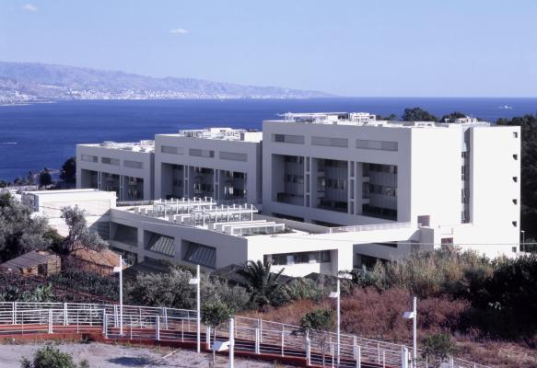
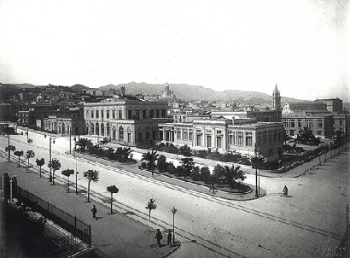
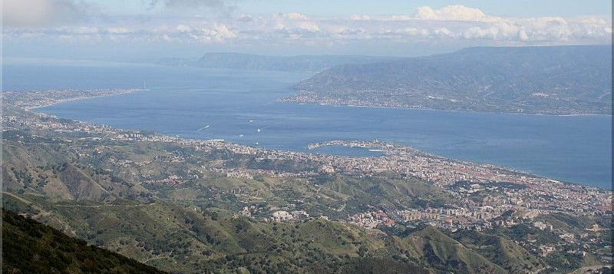
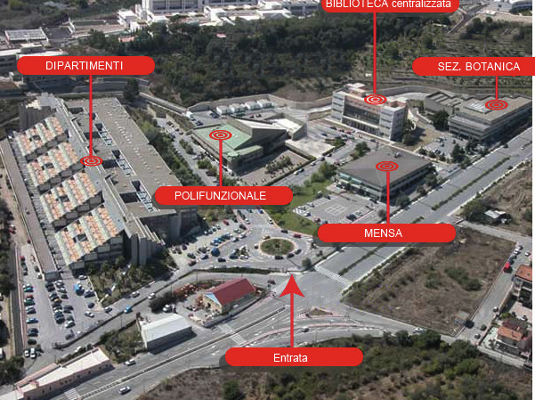
Development of master curricula for natural disasters risk management in Western Balkan countries
Introduction
Department of Engineering
Messina
The University
Department of Mathematic, Computer Sciences, Physic and Earth Sciences

Slide 6
Development of master curricula for natural disasters risk management in Western Balkan countries
People at Department of Engineering (Civil Engineering Section)
Academic staff:
4 Full Professors
5 Associate Professors
3 Researchers
Research staff
2 Assistant Professors
2 Research Assistants
11 Ph.D Students
3 Technicians

Slide 7
Development of master curricula for natural disasters risk management in Western Balkan countries
People at Department of Mathematic, Computer Sciences, Physic and Earth Sciences.
Academic staff:
2 Full Professors
4 Associate Professors
3 Researchers
Research staff
2 Technicians
3 Research Assistants
1 Ph.D Students

Slide 8
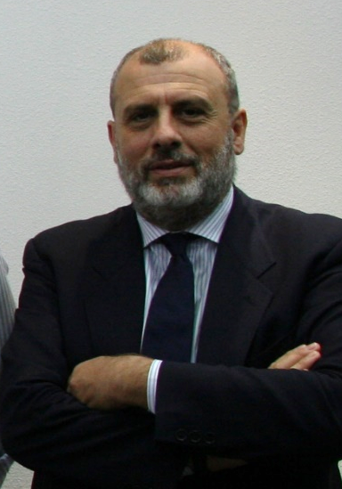
Development of master curricula for natural disasters risk management in Western Balkan countries
People involved in the project
Prof. Giuseppe Tito Aronica, Ph.D, Professor of Hydrology and River Basin Management at Department of Engineering , UNIME Scientific Responsible
Hydraulic engineer, Hydrologist, Flood risk expert
Relevant skills
flood propagation modelling
flood, flash flood and debris flow risk mapping
pluvial flooding and flood control in urban areas
flood risk management
flood damage evaluation
flood vulnerability analysis
Hydrology of extreme events
uncertainty analysis

Slide 9
Development of master curricula for natural disasters risk management in Western Balkan countries
People involved in the project
Prof. Giovanni Falsone, Ph.D, Professor of Structural Engineering at Department of Engineering
Relevant skills
seismic structural engineering
analysis of the structural behaviour under strong and/or near source earthquakes
approximated seismic analysis for complex buildings
passive control systems for structures under seismic actions (base-isolation and dissipation)
stochastic seismic analyses

Slide 10
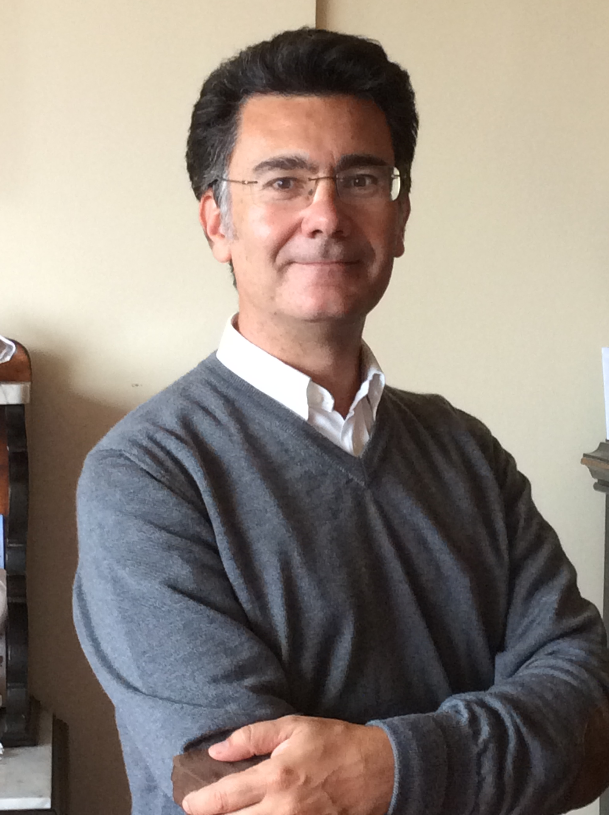
Development of master curricula for natural disasters risk management in Western Balkan countries
People involved in the project
Prof. Ernesto Cascone, Ph.D, Professor of Soil Mechanics and Geotechnics at Department of Engineering
Relevant skills
geotechnical engineering
analysis of seismic stability condition of earth retaining structures and evaluation of earthquake-induced permanent displacements for performance-based design
improvement of soft ground mechanical properties through preloading and vertical drains
evaluation of static and seismic stability conditions of natural slopes accounting for cyclic behavior of soils

Slide 11
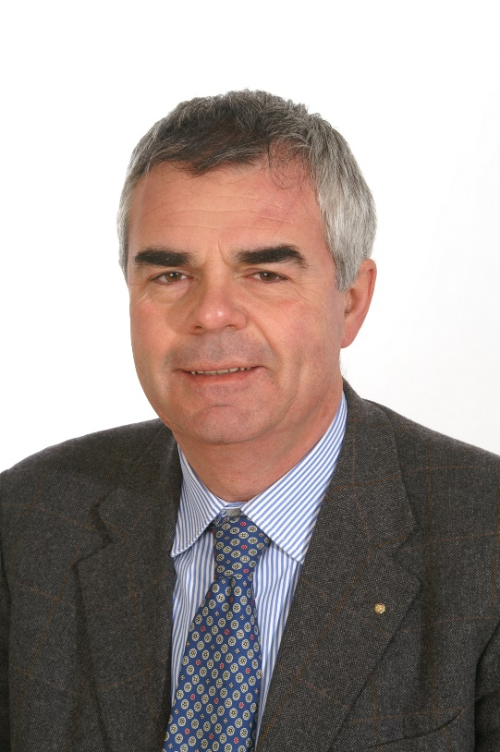
Development of master curricula for natural disasters risk management in Western Balkan countries
People involved in the project
Prof. Giovanni Randazzo, Professor of Coastal Geomorphology at Department of Mathematic and Informatics Sciences, Physic Sciences and Earth Sciences
Geomorphologist, Coastal Territorial Planner, Aerial Drone Cartographer
Relevant skills
DRONE LAB (Unmanned Aerial Vehicles - UAV) to develop and implement aerial UAV platform for capturing light and/or hyperspectral photographs of the land surface
Cartography via DRONE using HD cameras, laser scanner and thermal and spectral imaging
Coastal Geomorphology

Slide 12
Development of master curricula for natural disasters risk management in Western Balkan countries
People involved in the project
Prof. Giancarlo Neri, Professor of Solid Earth Geophysics at Department of Mathematic and Informatics Sciences, Physic Sciences and Earth Sciences
Geophysicist, Seismology and Volcano Physics expert
Relevant skills
Investigation of seismicity of Italy and Mediterranean region for identification of active faults, detection of seismogenic stress and seismic strain and modelling of local-to-regional scale geodynamic processes;
Development and tests of new methods for hypocenter location, stress inversion and analysis of earthquake temporal patterns, Investigation of crustal properties by tomographic inversion of seismic data and analysis of earthquake statistical distributions in space, time and energy domains.
Modelling of volcanic processes at Vulcano, Stromboli, Etna and St. Helens volcanoes by investigation of volcano seismicity and other geophysical and geological features related to volcanic fluid dynamics.
Estimate of seismic hazard and risk and applications for civil defence activity

Slide 13
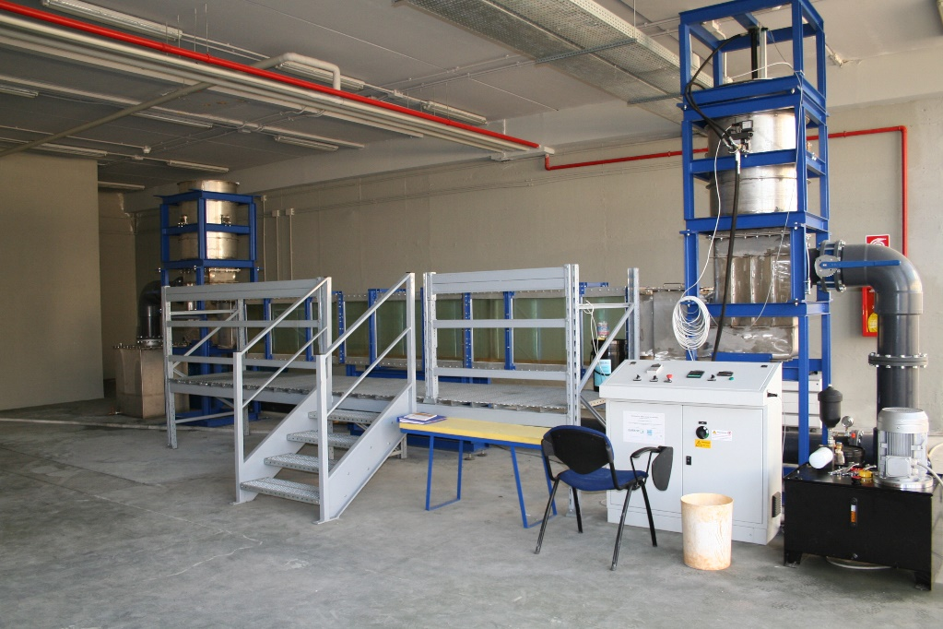
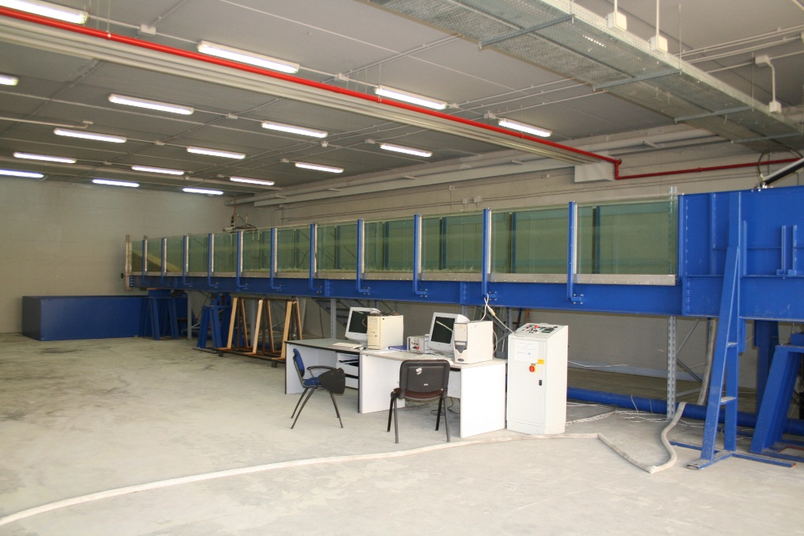
Development of master curricula for natural disasters risk management in Western Balkan countries
Laboratories supporting research and educational activities
Laboratory of Hydraulics and Hydraulic Engineering
Oscillating waves flume
Length: 5 m
Cross section: 0.40 x 0.60 m
Tilting flume with wave generator
Length: 15m
Cross section: 0.40 x 0.80 m

Slide 14
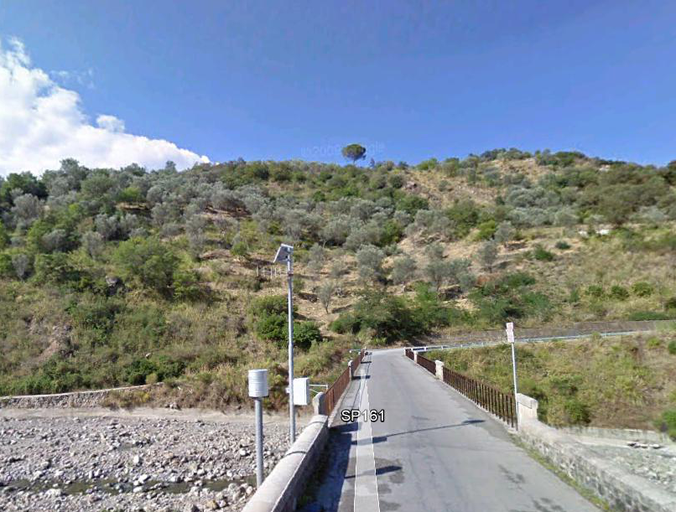
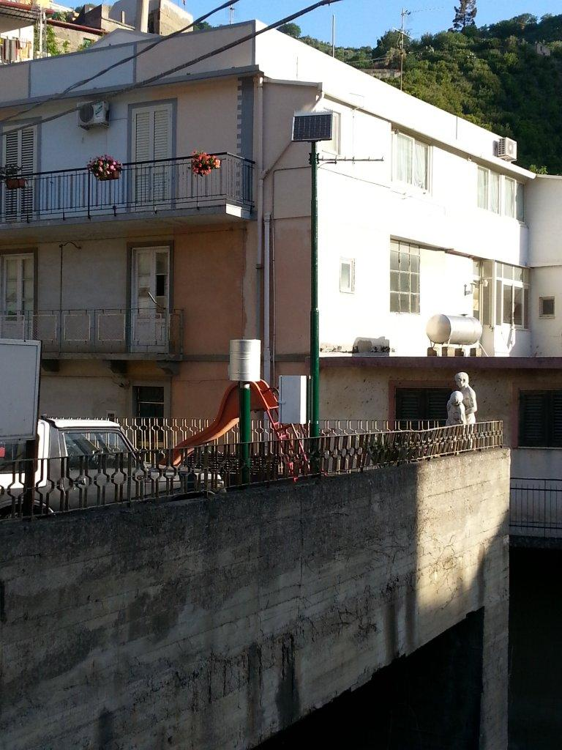
Development of master curricula for natural disasters risk management in Western Balkan countries
Laboratories supporting research and educational activities
Experimental stations for river monitoring (flash flood and small catchments hydrology)

Slide 15
Development of master curricula for natural disasters risk management in Western Balkan countries
Laboratories supporting research and educational activities
EUROLAB - Laboratory of Structural Engineering of Center of Excellence, Research and Innovation for large Structures and Infrastructures (C.E.R.I.S.I.)
New laboratory for testing great base-isolators, dampers and bridge cables

Slide 16
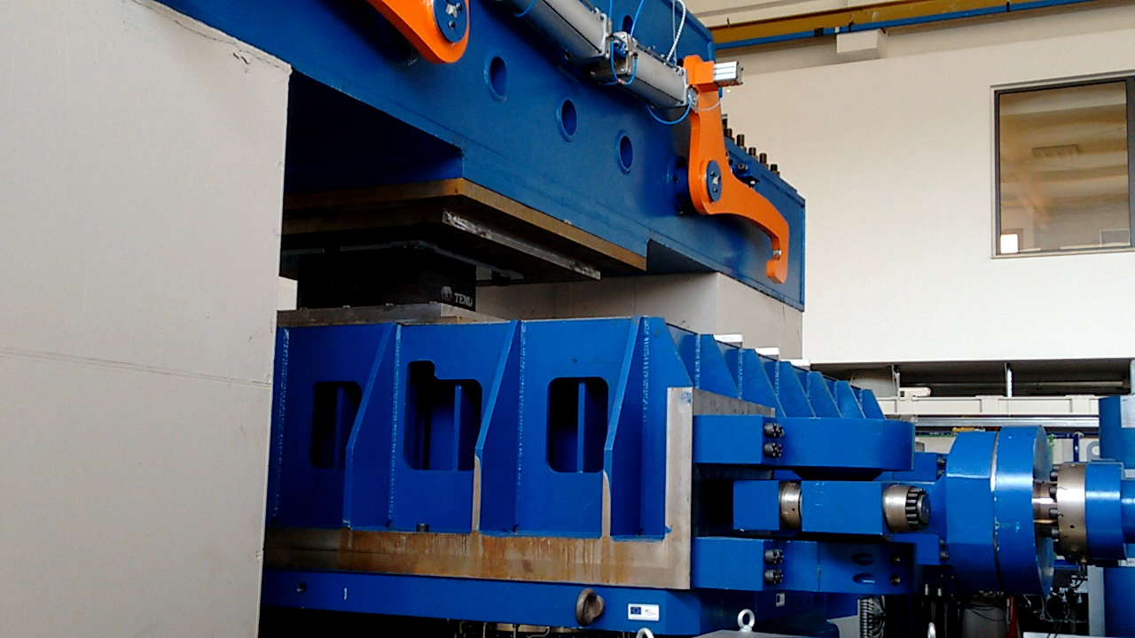
Development of master curricula for natural disasters risk management in Western Balkan countries
Laboratories supporting research and educational activities
EUROLAB - Laboratory of Structural Engineering of Center of Excellence, Research and Innovation for large Structures and Infrastructures (C.E.R.I.S.I.)

Slide 17
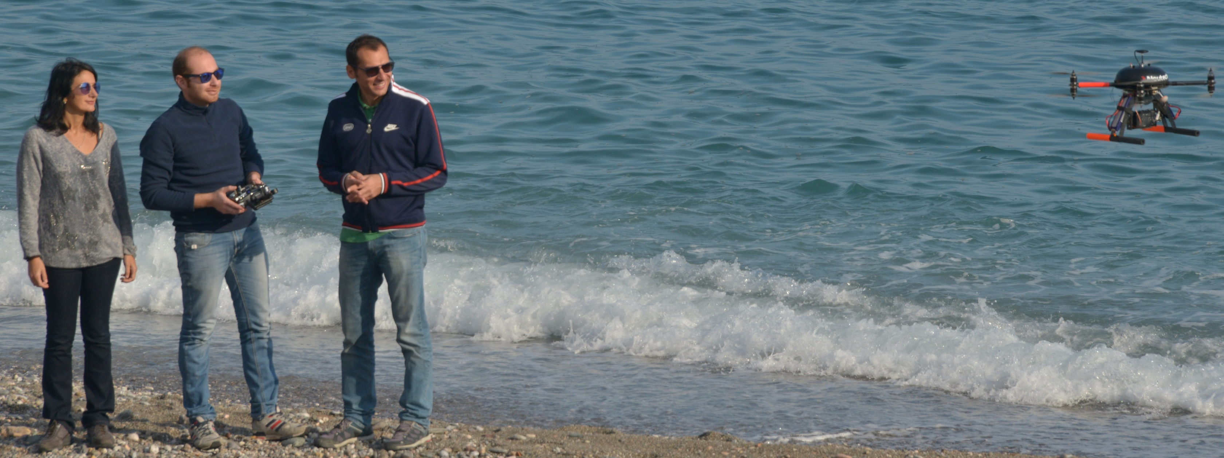

Development of master curricula for natural disasters risk management in Western Balkan countries
Other activities supporting research and educational activities
GeoloGIS srl is an University’s spin-off created to implement the research action of the Geomorphological Lab about sustainable land planning

Slide 18
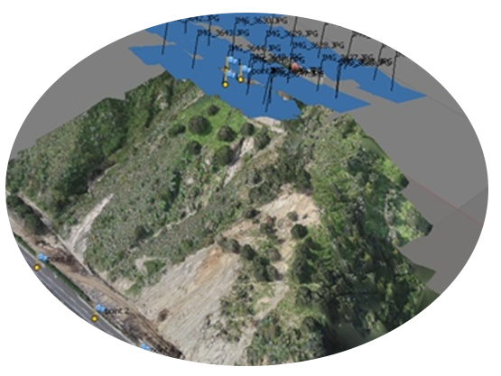
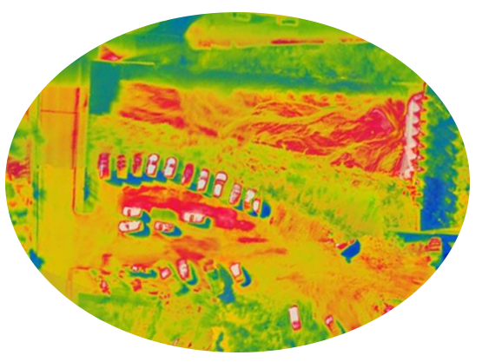
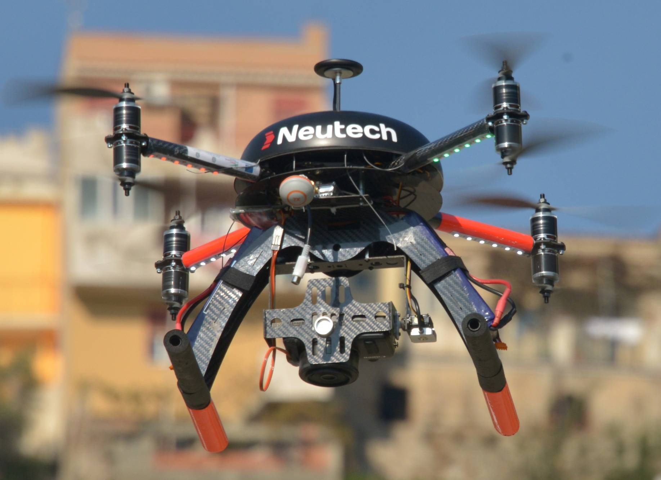
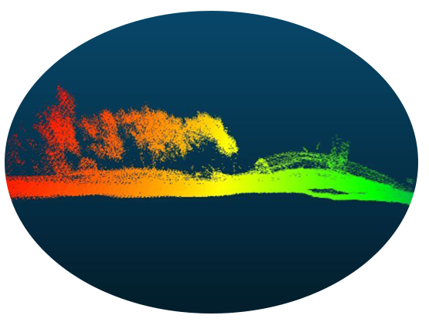
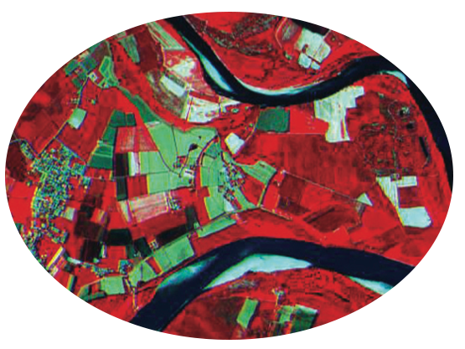
Development of master curricula for natural disasters risk management in Western Balkan countries
Other activities supporting research and educational activities
TOPOGRAPHIC
THERMOGRAPHIC
LIDAR – LASER SCANNER
MULTISPECTRAL

Slide 19
Development of master curricula for natural disasters risk management in Western Balkan countries
Thank you for your attention
garonica@unime.it

Slide 20
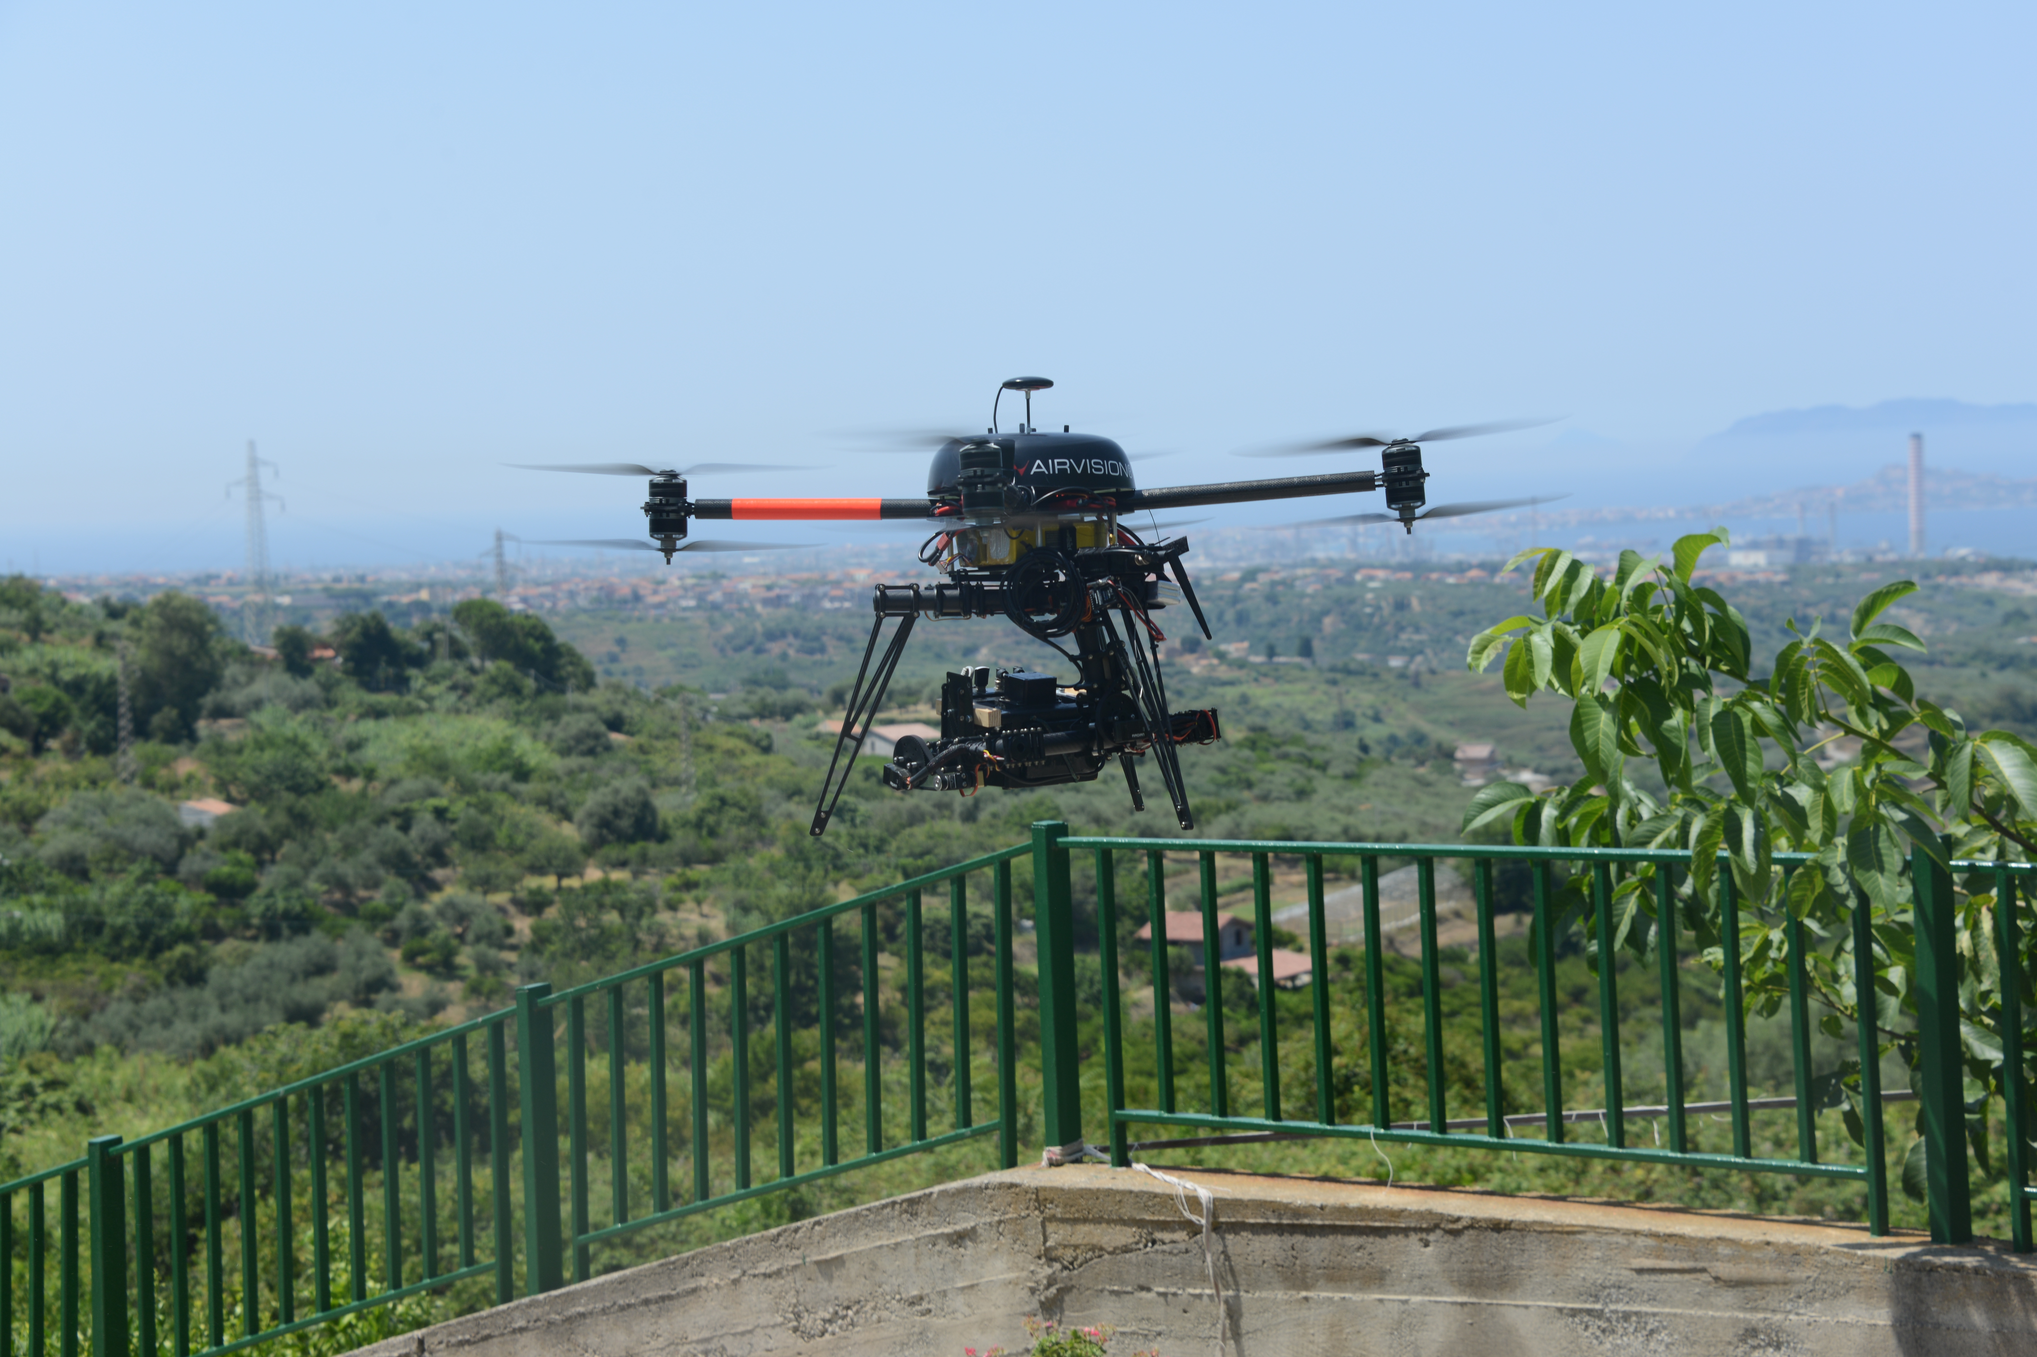
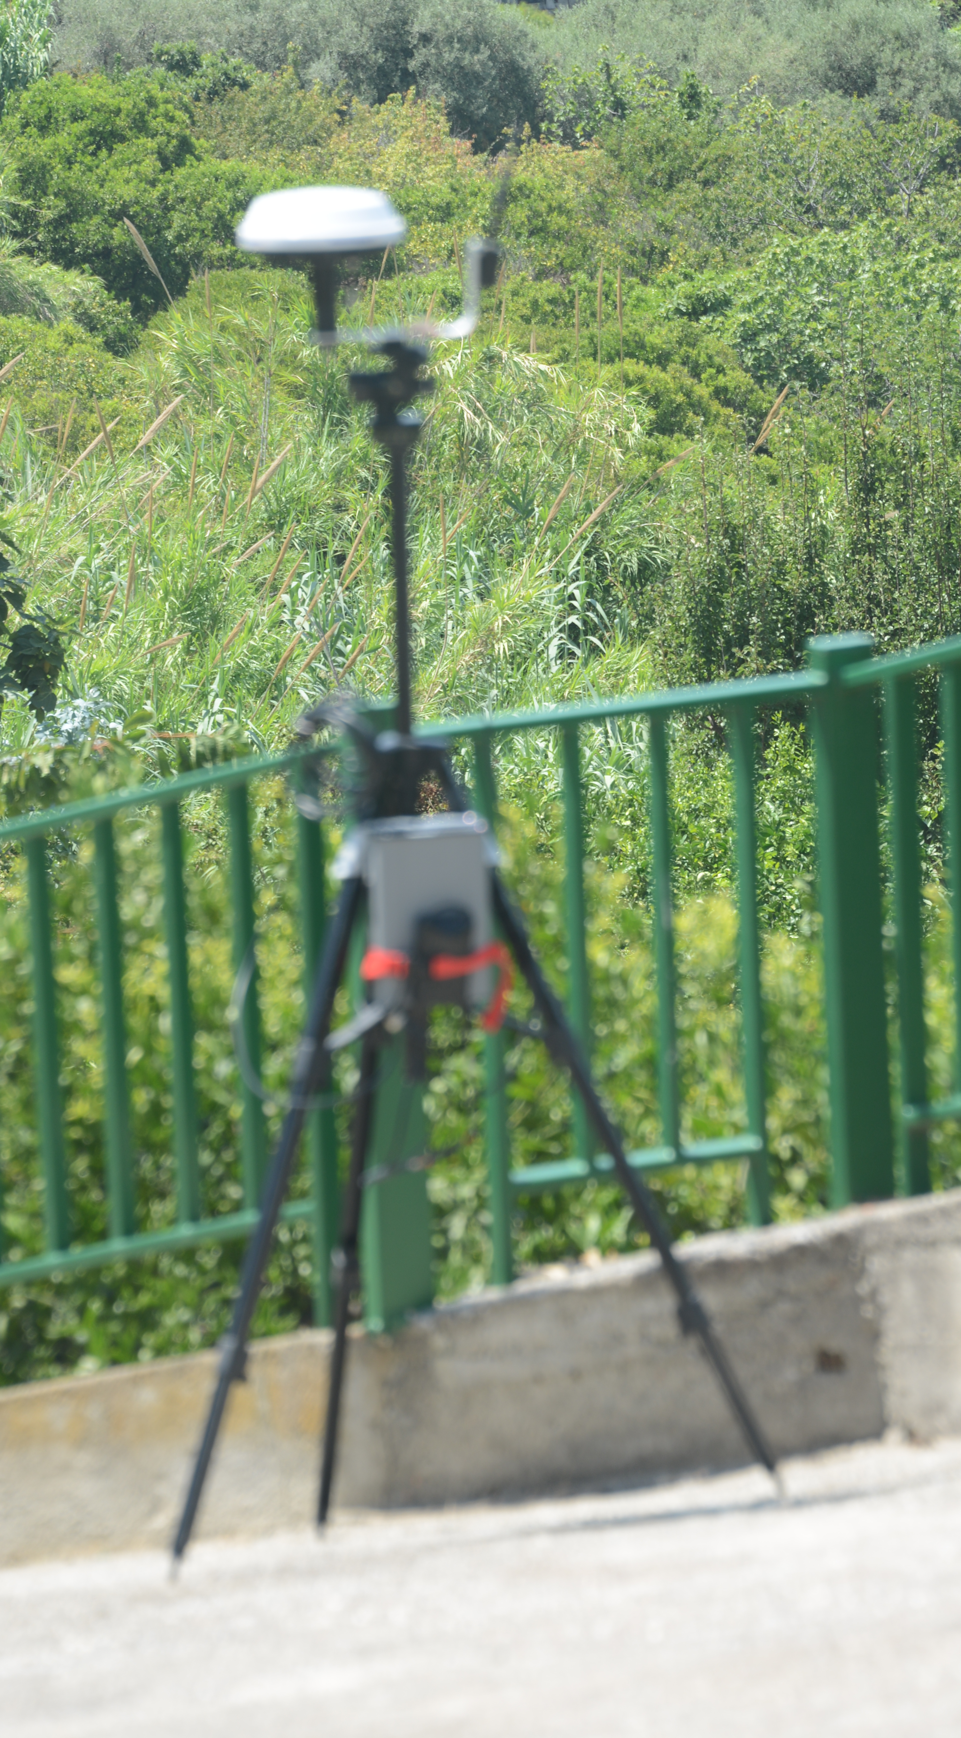
Development of master curricula for natural disasters risk management in Western Balkan countries

Slide 21
Development of master curricula for natural disasters risk management in Western Balkan countries
Laboratories supporting research and educational activities
Many laboratories are active for research and learning: 1) Laboratory of Hydraulic and Hydraulic Works, Laboratory of Geotechnics, and the EUROLAB - Laboratory of Structural Engineering of Center of Excellence, Research and Innovation for large Structures and Infrastructures (C.E.R.I.S.I.)
Laboratory of Structural Analysis and Seismic Engineering
Laboratory of Geotechnical Engineering
Laboratory of Road Engineering
Laboratory of Transportation Engineering
Laboratory of Hydraulics and
Hydraulic Engineering with:
Tilting flume with wave generator
Length: 15m
Cross section: 0.40 x 0.80 m
Oscillating waves flume
Length: 5 m
Cross section: 0.40 x 0.60 m

Slide 22
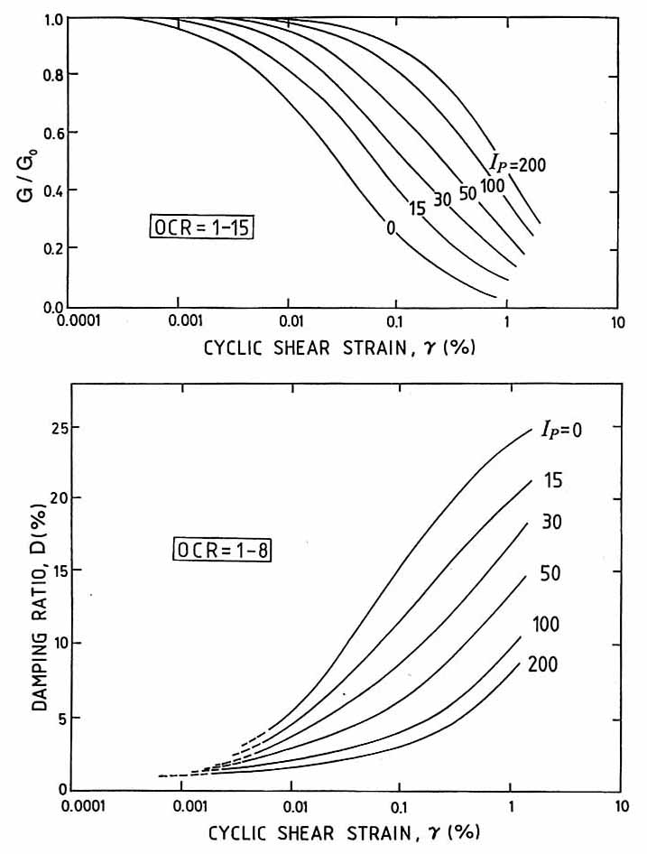

Seismic response analysis
ground surface
outcropping
a_{max} (g)
bedrock
a_{g} (g)

Slide 23
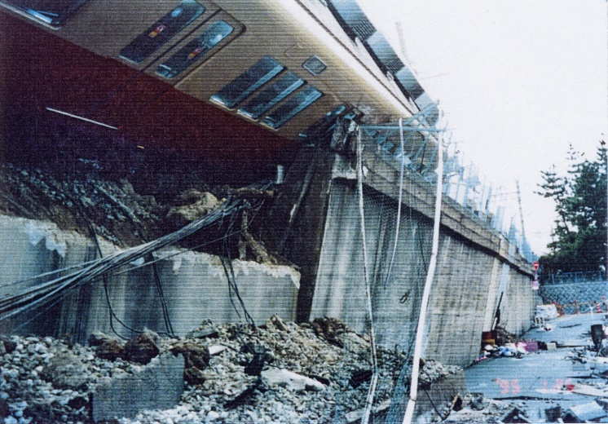
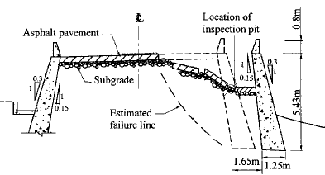
Retaining walls
ground motion
i
numerical model
c, φ, γ
u=0
k_{h}W_{s}
β
H
W_{s}
δ
k_{h}W_{w}
α
S_{ae}
Kobe (Japan, 1995)
W_{w}
c_{b}, φ_{b}
α_{b}
displacement response

Slide 24
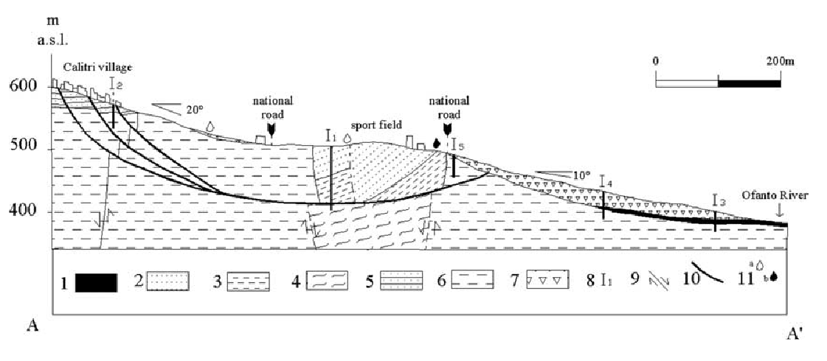
Seismic slope stabilty
Calitri landslides
lunghezza 800 m
profondità 100 m
Multi-block model
u_{n}
ground motion amplification
block i
t
change of geometry
u_{i}
block 1
sliding
variation of shear strenght
u₁
surface
s_{H}
s_{v}
s
Vertical displacement (m)
7
Spostamenti osservati
8
Observed displacements
1÷2 m main scarp
(block n.9)
≈ 0.8 m city
(blocks n. 7 e n.8)
proposed model
9

Slide 25
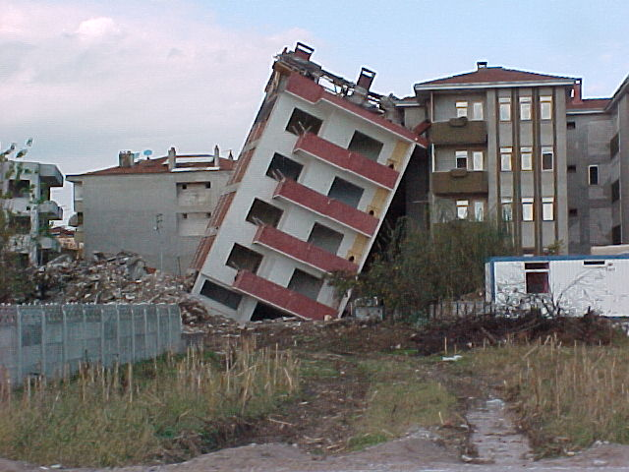
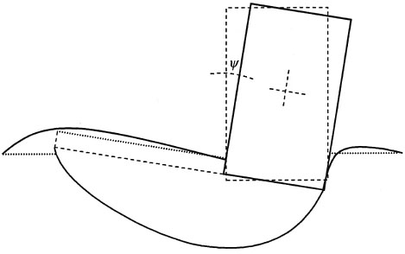
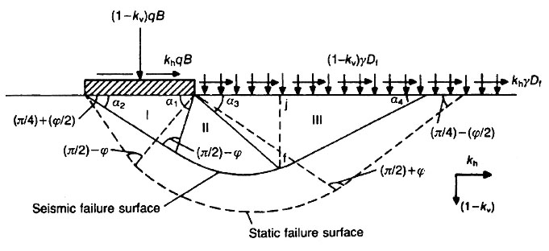
Shallow foundations
Numerical model
Prediction

